Slide 1
OpenNebula and Ceph in MIMOS
Advanced Computing Lab (ACL), MIMOS

Slide 2
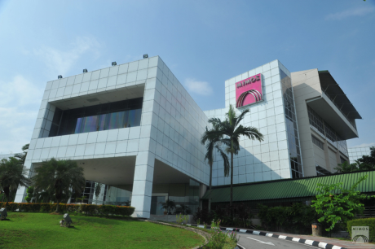
MIMOS
A R&D institute funded by the Government of Malaysia specialize in ICT
Sole charter is applied research, in line with its vision to steer itself into a premier applied research center in frontier technologies that impact Malaysians and the global community.

Slide 3







Mi-Cloud: Road Towards Software-Defined Instrastructure
Virtual Data center
Virtual Data center
Virtual Data center
Software-Defined Infrastructure
Cloud
Cloud
Cloud
XaaS
Automated Complex Systems Management through Software
Virtualize IT Infrastructure and Delivered As-A-Service
Software Management and Automation
Abstract the Intelligent
Server
Storage
Network
Security

Slide 4

















Mi-Cloud: Software Overview
Mi-Trust
Mi-UAP
Mi-Mocha
Mi-Latte
Marketplace
Portal
Virtual Data Center
VM
VM
Mi-ROSS
Distributed Storage
SDN
Controller
Mi-NetVirX
Virtual Network
Physical Infrastructure
Storage
Network
Compute

Slide 5
WAN Based Archiving Infrastructure using Ceph: From POC to Realization
Initial POC simulates both KHTP and TPM with 3 zones using existing but slightly different hardware configuration (different disk specs).
For actual implementation, replicate POC setup but with similar hardware configurations.
  KHTP zones setup is all in a single data center
  TPM zones setup uses both DC1 and DC2
Initial implementation targets total estimated raw storage of roughly 148TB.

Slide 6
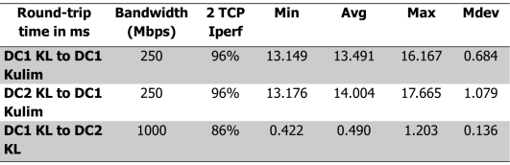
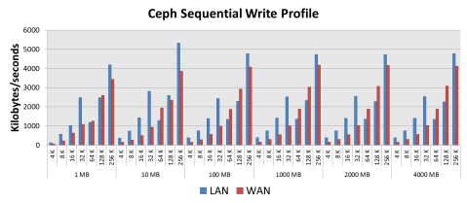
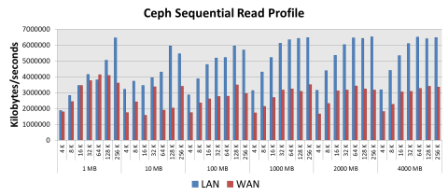
POC Benchmark Results and Other Observations
Network Benchmark
Observations:
POC results suggest that irrespective of LAN or WAN, Ceph scaled well in all scenarios whether its Read or Write.
Given difference of WAN bandwidth, performance drop in WAN scenario is expected.

Slide 7
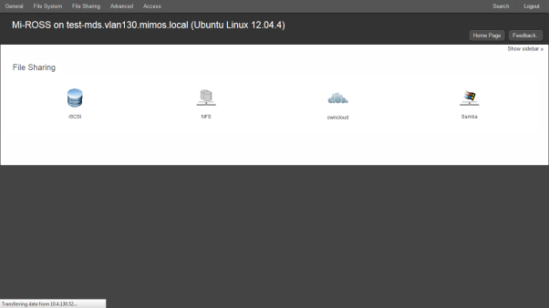
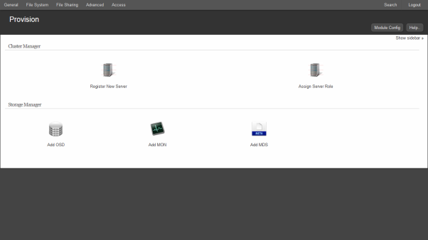
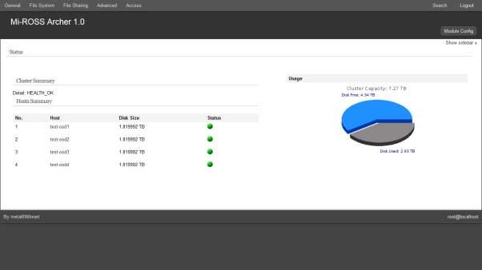
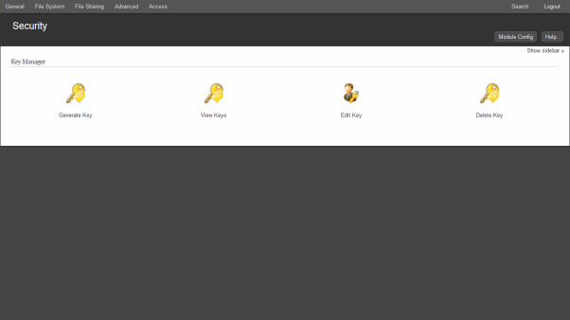
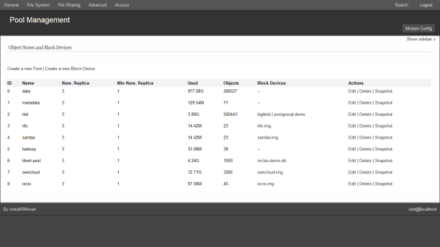
Mi-ROSS Archer: Simple NAS over Ceph
Simple Provisioning
File Sharing/NAS Options
Pool Management
Key Management
Monitoring

Slide 8

Timeline
  v2.0 (Crimson Eye)
  v1.5 (Brilliant)
Q2 ’16
  Auto Tuning
  Self Healing
  v1.0 (Archer)
Q4 ’15
  Key management
  LDAP/AD integration
  Placement Group/CRUSH Management
  Hadoop
  Mi-Cloud v2.0
  Beta Release
Q2 ‘15
  Pool management
  File System Management
    Samba
    NFS
  Device Management
    iSCSI
  ownCloud
  Monitoring
  Dashboard
Q3 ‘14
  Early Tester Program
  Alpha Release
Q2 ’14
Performance Tuning
Features Testing

Slide 9


OpenNebula + Ceph
Mi-Cloud
Pool Management
Key Management
Image Management
Monitoring
Accounting
Mi-ROSS

Slide 10
Challenges
Automation
  Pool management
  Image Management
  Key Management
Monitoring
  Calamari?
Accounting

